Slide 1
Music Festival
G12 109306043 黃尹彤 109306060 劉家妤 109306061 呂學柏

Slide 2
User and Motivation
For people who love rock bands, metal bands, and indie bands, the Google Search Engine may not meet their needs, since it may give results of the music concerts held by Taichung City Mayor Lu Xiu-Yan or other useless information display. Obviously, it did not meet expectations, so we want to re-weight and do sorting to provide this group of people a better and more realistic result.

Slide 3
Commercial Analysis
With our search engine, people who love independent music can enjoy a better searching experience.
Thus, there may be sponsors or advertising placements on our website. Through embedded advertising, we can at least increase income. At the same time, create a win-win situation for both users and advertisers.

Slide 4
Front-End
Back-End
WebTree
Result
Search.jsp
WebPage
GoogleQuery
WebNode
googleitem.jsp
Keyword
KeywordList
KeywordComparator

Slide 5
Keyword
name: String weight: double count: int
toString() : String getName() : String getWeight() : double
Result
name: String nodeScore: double url: String
toString() : String
WebPage
name: String url: String wordCounter: WordCounter score: double
setScore(ArrayList<Keyword> keywords) : void
WordCounter
urlStr: String content: double
fetchContent() : String countKeyword(String keyword) : int
KeywordCompartor
compare(Keyword o1, Keyword o2) : int
WebNode
root: WebNode result: static Result
setPostOrderScore(ArrayList<Keyword> keywords) : void setPostOrderScore(WebNode startNode, ArrayList<Keyword> keywords) : void eularPrintTree() : void eularPrintTree(WebNode startNode) : void repeat(String str,int repeat) : String setTreeOrder() : void swap(int aIndex, int bIndex) : void quickSort(int leftbound, int rightbound) : void selectionSort(int array[]) : void insertionSort(int array[]) : void
WebTree
nodeScore:double parent: WebNode webpage: WebPage children: ArrayList<WebNode> webType: String
setWebType(String type) : void setNodeScore(ArrayList<Keyword> keywords) : void addChild(WebNode child) : void isTheLastChild() : Boolean getDepth() : int
GoogleQuery
searchNum: int searchKeyword :String url: String content : String title : String results : String citeUrl : static String k : static KeywordList heap:PriorityQueue<WebNode>
fetchContent() : String encodeURL(String url) : static String
TestProject
serialVersionUID : static
doGet(HttpServletRequest request, HttpServletResponse response) : void doPost(HttpServletRequest request, HttpServletResponse response) : void
WebCompartor
compare(WebNode n1, WebNode n2): int

Slide 6
Keywords & weight
音樂祭 | 20.0
獨立音樂 | 10.0
獨立樂團 | 10.0
樂團 | 10.0
台灣 | 4.5
臺灣 | 4.5
陣容 | 3.0
票價 | 3.0
搖滾 | 3.0
龐克 | 3.0
金屬 | 3.0
另類 | 3.0
滅火器 | 2.0
怕胖團 | 2.0
血肉 | 2.0
閃靈 | 2.0
美秀 | 2.0
拍謝少年 | 2.0
老破麻 | 2.0
荷爾蒙少年 | 2.0
海豚刑警 | 2.0
無妄 | 2.0
大港 | 1.5
浪人 | 1.5
漂遊 | 1.5
火球 | 1.5
赤聲 | 1.5
爛泥 | 1.5
山海屯 | 1.5
五月天 | -10.0
周興哲 | -10.0
盧秀燕 | -10.0
流行音樂 | -20.0
score += keyword.weight * wordCounter.countKeyword(keyword.name);

Slide 7
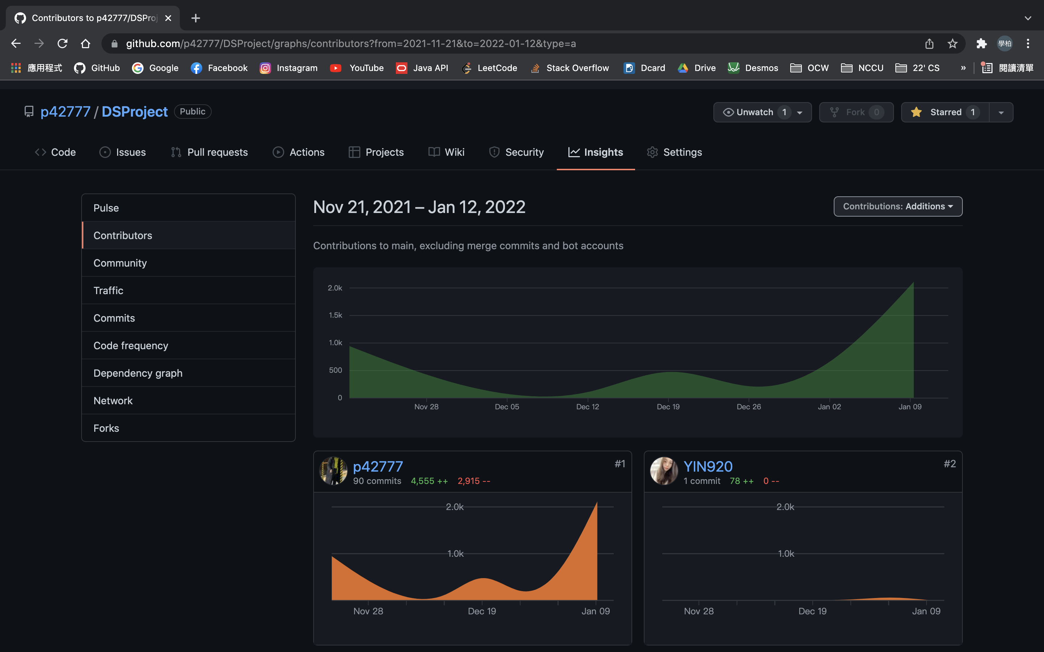
GitHub Insights

Slide 8
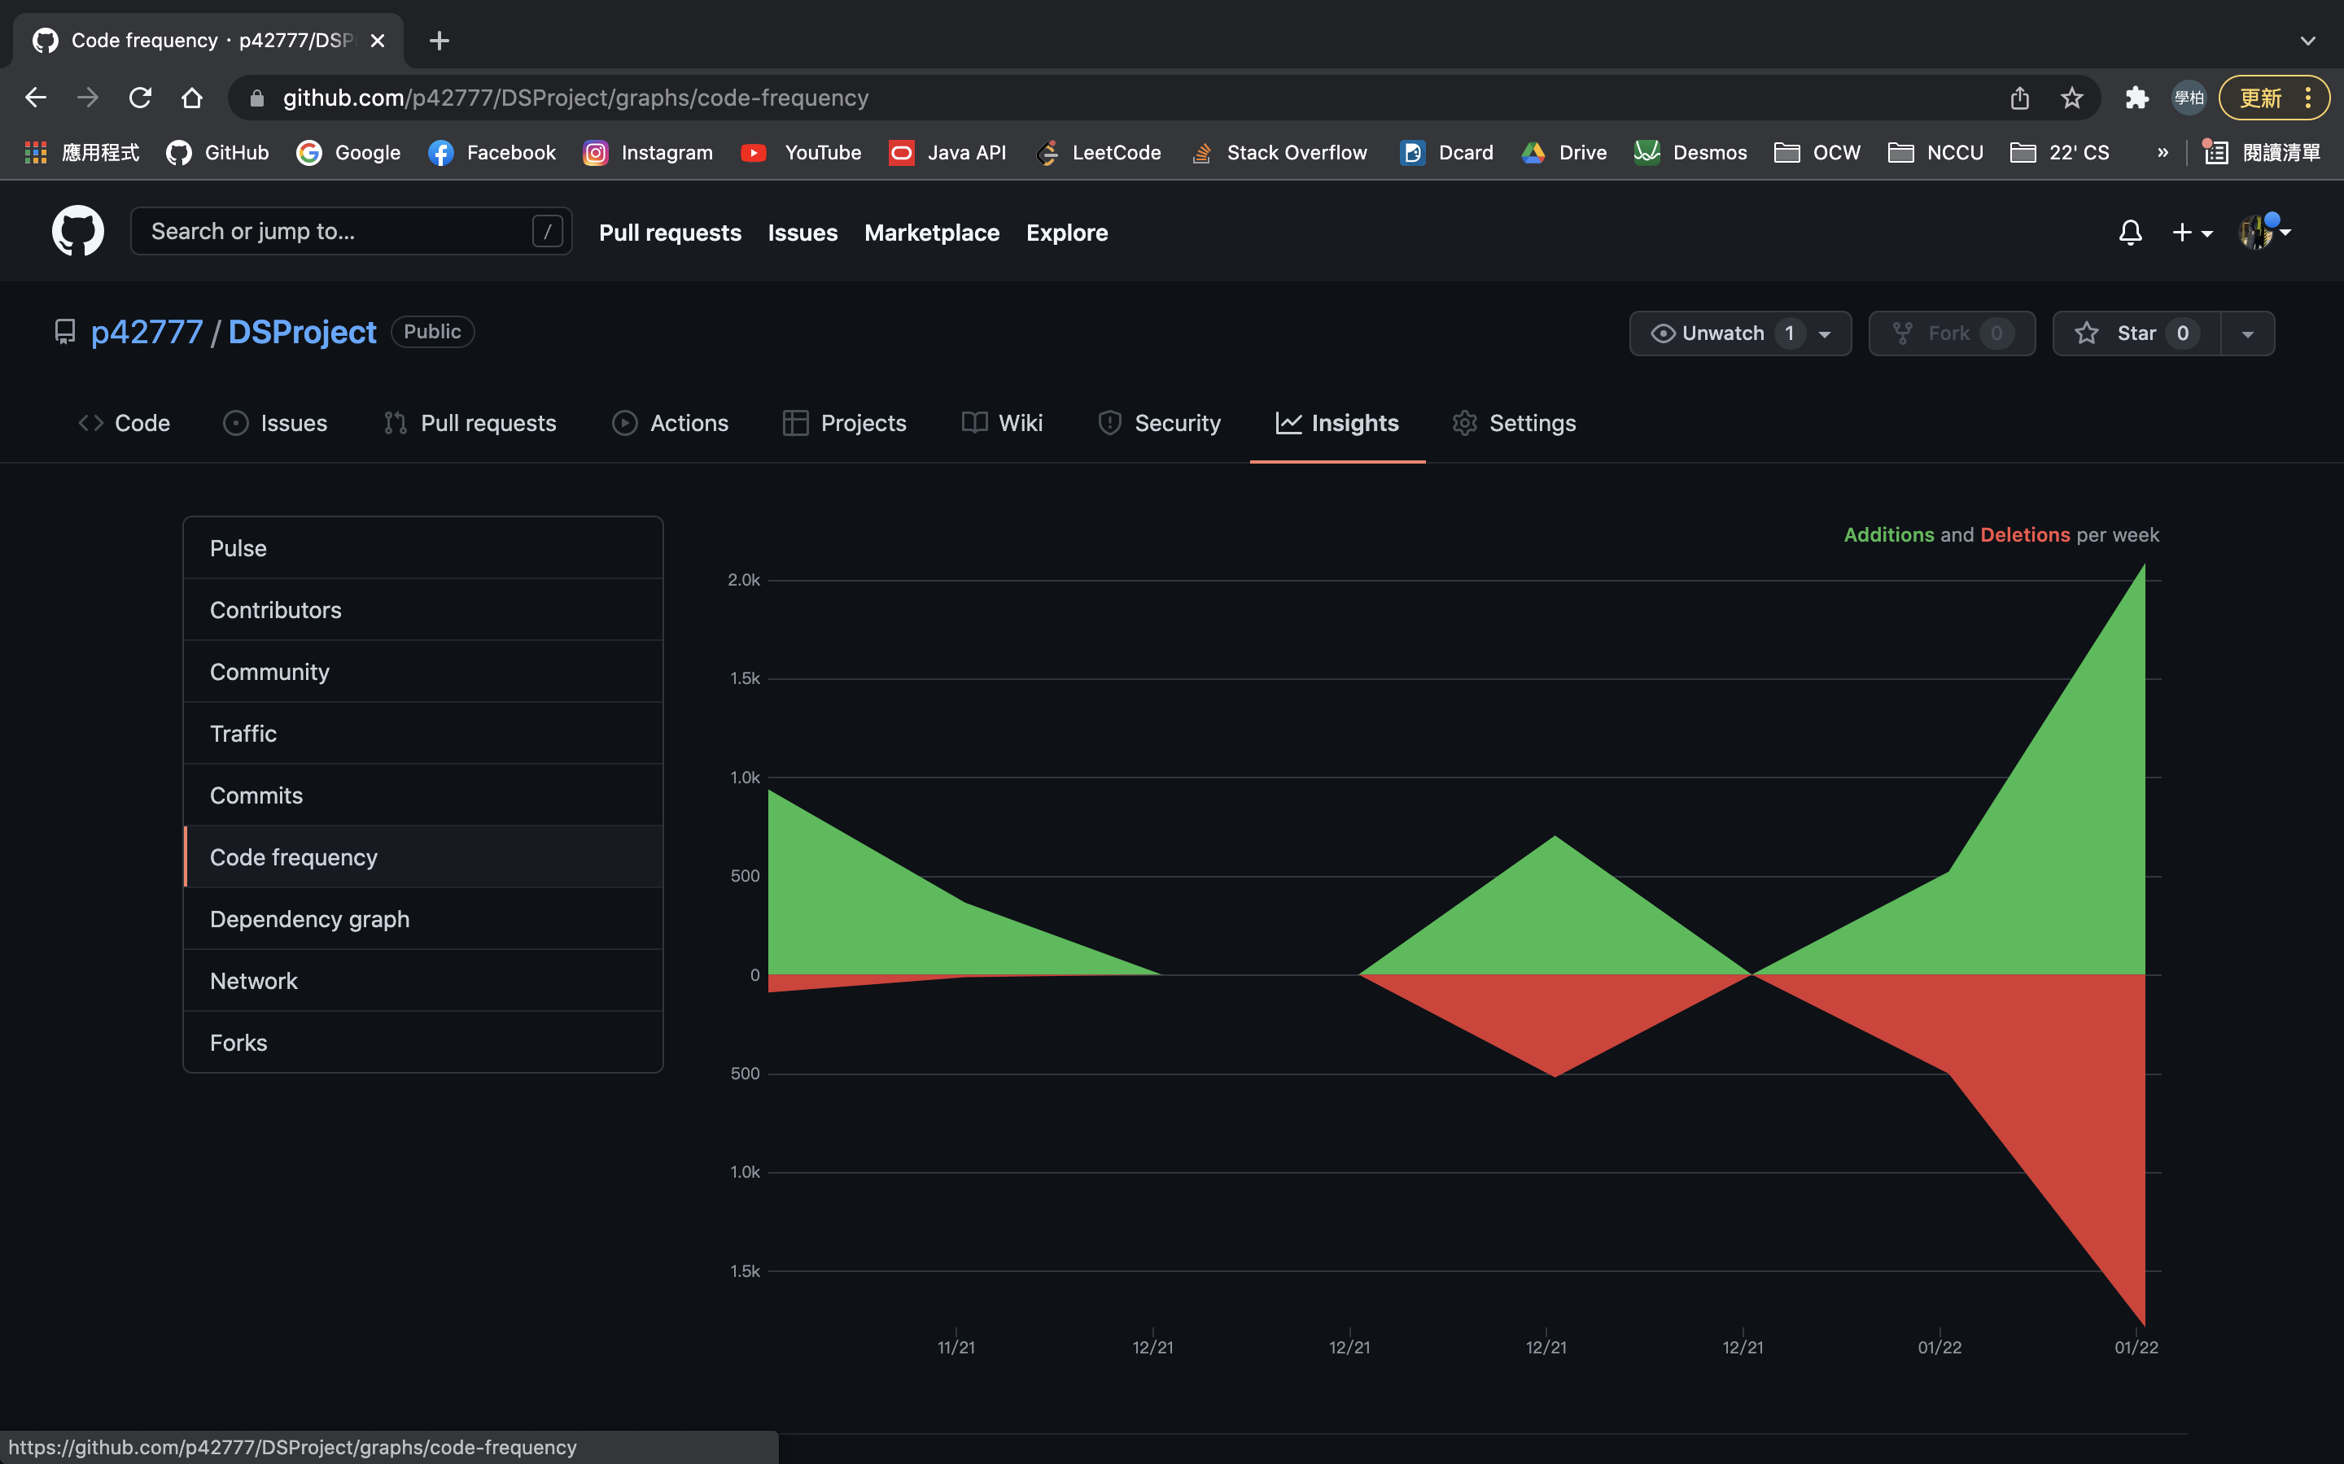
GitHub Insights

Slide 9
Work Division & Contributions:
Name | Contributions
呂學柏 | Back-End & Front-End Coding, BE/FE Connection, Debugging, Slides
黃尹彤 | UML Diagram, Proposals
劉家妤 | UML Diagram, Proposals, Slides, JSP Background Picture

